Slide 1


Detection Of Anomaly Using Graph Fairing Convolutional Networks
Omri Sharof, Boris Shoostin
24-2-R-6
Supervised By – Prof. Zeev Volkovich & Dr. Renata Avros

Slide 2
Problem Definition: Anomalies In Scientific Citations
Problem: Scientific citation may be counterfeit (citation manipulation, misleading quotes), undermining the credibility of the research.
Purpose: Detecting these anomalies citations in graph-structured data, where nodes represent papers and edges represent citations.
Goal: The project aims to propose a method to recognize citation anomalies efficiently.

Slide 3
Approach Overview
Solution: Our objective is to apply Graph Fairing Convolutional Networks (GFCNs) to model and analyze citation relationships within scientific literature.
Techniques Used: Node2Vec, Isolation Forest, GFCN, Jacobi Method.

Slide 4
Graph Fairing Convolutional Networks (GFCN)
GFCN uses a multi-layer architecture, together with skip connections, and non-linear activation functions to extract high-order information of graphs as discriminative features.
GFCN inherits all benefits of GCNs, including accuracy, efficiency and ease of training.
Key Concepts:
Graph fairing
Graph convolution
Skip Connections

Slide 5
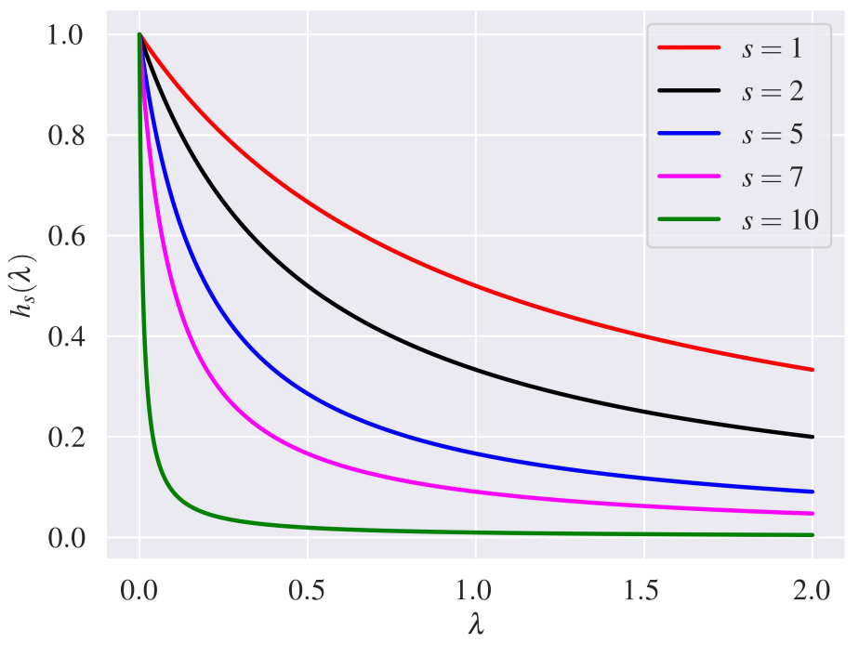
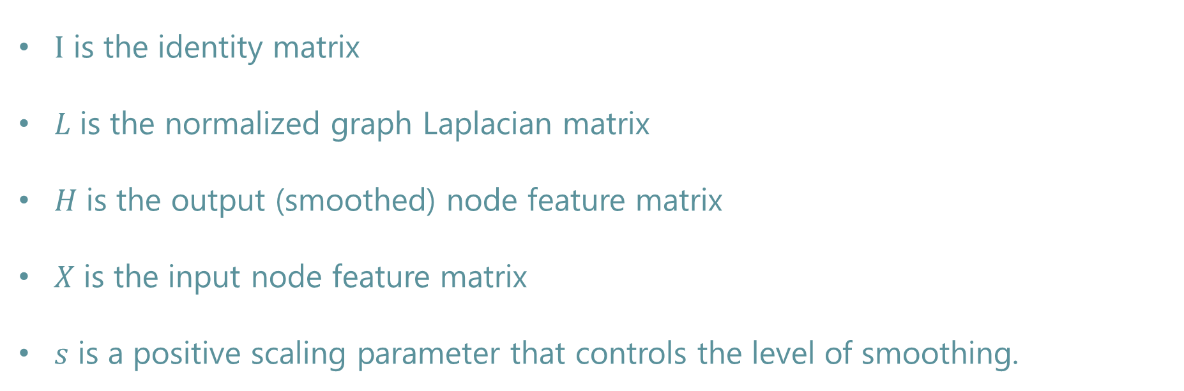
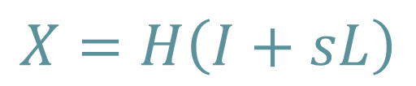
Graph Fairing
The core idea behind graph fairing is to smooth node features (or signals) on the graph by attenuating high-frequency noise and preserving the essential graph structure.
$$X=H\left(I+sL\right)$$
$I$ is the identity matrix
𝐿 is the normalized graph Laplacian matrix
𝐻 is the output (smoothed) node feature matrix
𝑋 is the input node feature matrix
𝑠 is a positive scaling parameter that controls the level of smoothing.
Notes:
Graph Fairing is inspired by the implicit fairing concept in geomtry processing for triangular meth snoothing. GFCN uses a skip connection to combine both the initial node represntation and the aggregated node neighborhood representation
Enabling it to memorize information across distant nodes.
Most GC with skip connections are based on heuristics, GFCN is motivated by implicit fairing and Jacobi iterative method.
The concept of implicit fairing in geometry processing, particularly in the context of triangular mesh smoothing, is a technique used to remove noise and smooth the surface of a 3D mesh while preserving important geometric features such as edges and corners.

Slide 6
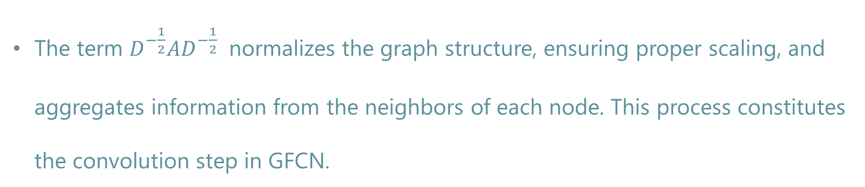
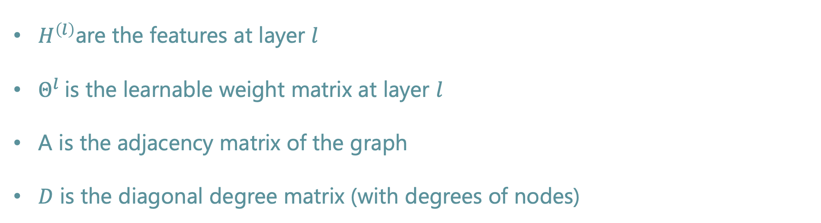
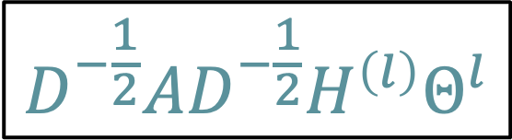
Convolution in GFCN
The operation aggregates each node’s information from its neighboring nodes.
This is analogous to how a pixel in a convolutional neural network (CNN) aggregates information from neighboring pixels.
$H^{\left(l\right)}$are the features at layer $l$
$Θ^{l}$is the learnable weight matrix at layer $l$
A is the adjacency matrix of the graph
𝐷 is the diagonal degree matrix (with degrees of nodes)
$$D^{−\frac{1}{2}}AD^{−\frac{1}{2}}H^{\left(l\right)}Θ^{l}$$
The term $D^{−\frac{1}{2}}AD^{−\frac{1}{2}}$​ normalizes the graph structure, ensuring proper scaling, and aggregates information from the neighbors of each node. This process constitutes the convolution step in GFCN.
Notes:
Graph Fairing is inspired by the implicit fairing concept in geomtry processing for triangular meth snoothing. GFCN uses a skip connection to combine both the initial node represntation and the aggregated node neighborhood representation
Enabling it to memorize information across distant nodes.
Most GC with skip connections are based on heuristics, GFCN is motivated by implicit fairing and Jacobi iterative method.
The concept of implicit fairing in geometry processing, particularly in the context of triangular mesh smoothing, is a technique used to remove noise and smooth the surface of a 3D mesh while preserving important geometric features such as edges and corners.

Slide 7
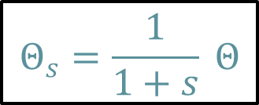
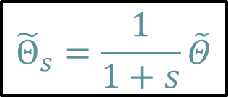
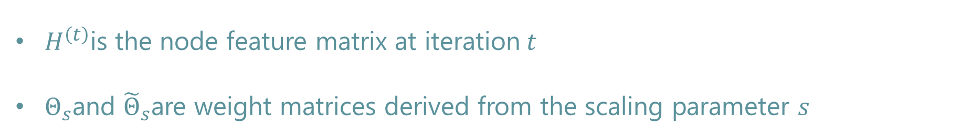

Iterative Solution Using the Jacobi Method
The Jacobi method is used to iteratively solve the implicit fairing equation. This ensures efficient and stable graph smoothing. The Jacobi iteration for solving the equation is given by:
$$H^{\left(t+1\right)}=D^{−\frac{1}{2}}AD^{−\frac{1}{2}}H^{\left(t\right)}Θ_{s}+X{\tilde{Θ}}_{s}$$
This iterative process converges to the solution of the fairing equation, smoothing the node features over multiple iterations.
$H^{\left(t\right)}$is the node feature matrix at iteration$t$
$Θ_{s}$and ${\tilde{Θ}}_{s}$are weight matrices derived from the scaling parameter 𝑠
$$Θ_{s}=\frac{1}{1+s} Θ$$
$${\tilde{Θ}}_{s}=\frac{1}{1+s}\tilde{Θ}$$
Notes:
Graph Fairing is inspired by the implicit fairing concept in geomtry processing for triangular meth snoothing. GFCN uses a skip connection to combine both the initial node represntation and the aggregated node neighborhood representation
Enabling it to memorize information across distant nodes.
Most GC with skip connections are based on heuristics, GFCN is motivated by implicit fairing and Jacobi iterative method.
The concept of implicit fairing in geometry processing, particularly in the context of triangular mesh smoothing, is a technique used to remove noise and smooth the surface of a 3D mesh while preserving important geometric features such as edges and corners.

Slide 8
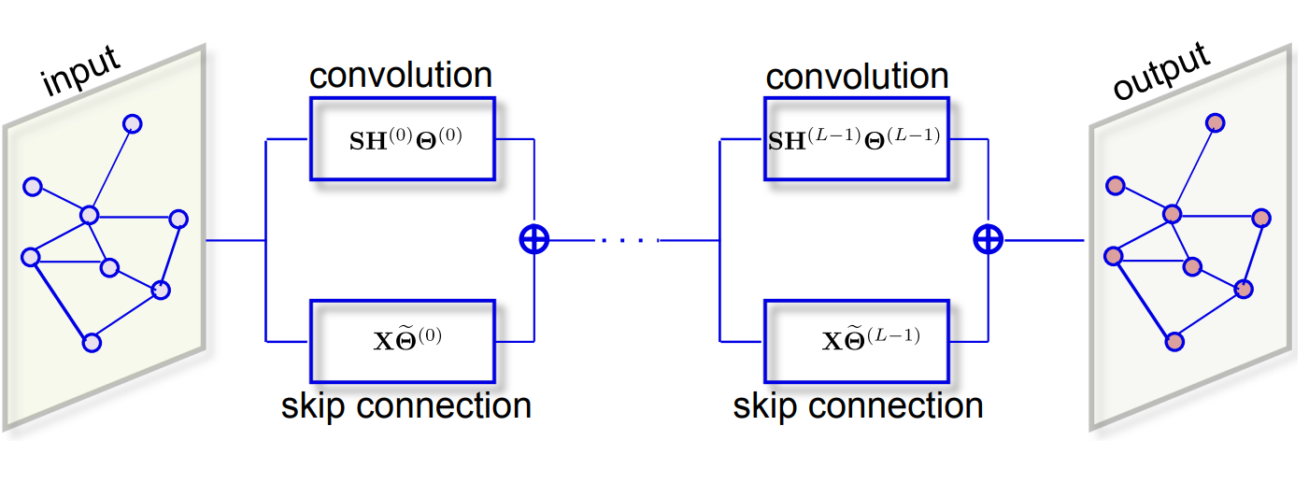
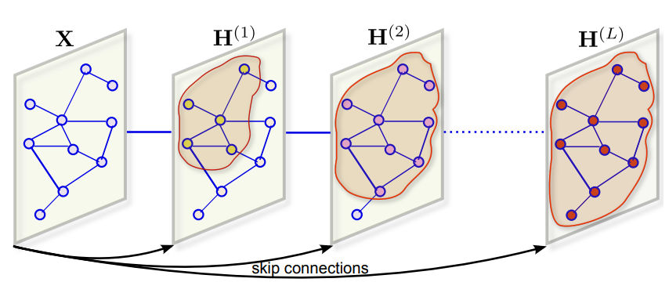
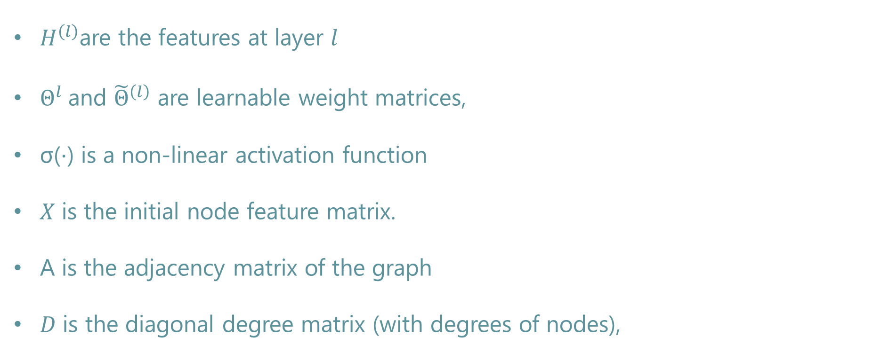
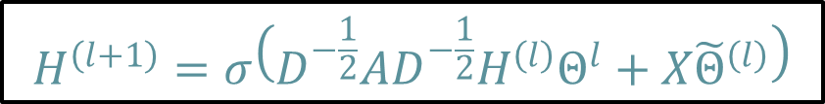
Propagation Rule and Skip Connections
Skip connections allow the network to reuse initial node features at each layer, which helps in stabilizing training and retaining important information across layers. The layer-wise propagation rule for GFCN, which includes the convolution and skip connection, is:
$$H^{\left(l+1\right)}=σ\left(D^{−\frac{1}{2}}AD^{−\frac{1}{2}}H^{\left(l\right)}Θ^{l}+X{\tilde{Θ}}^{\left(l\right)}\right)$$
$H^{\left(l\right)}$are the features at layer $l$
$Θ^{l}$and ${\tilde{Θ}}^{\left(l\right)}$ are learnable weight matrices,
σ(⋅) is a non-linear activation function
𝑋 is the initial node feature matrix.
A is the adjacency matrix of the graph
𝐷 is the diagonal degree matrix (with degrees of nodes),
Notes:
Graph Fairing is inspired by the implicit fairing concept in geomtry processing for triangular meth snoothing. GFCN uses a skip connection to combine both the initial node represntation and the aggregated node neighborhood representation
Enabling it to memorize information across distant nodes.
Most GC with skip connections are based on heuristics, GFCN is motivated by implicit fairing and Jacobi iterative method.
The concept of implicit fairing in geometry processing, particularly in the context of triangular mesh smoothing, is a technique used to remove noise and smooth the surface of a 3D mesh while preserving important geometric features such as edges and corners.

Slide 9
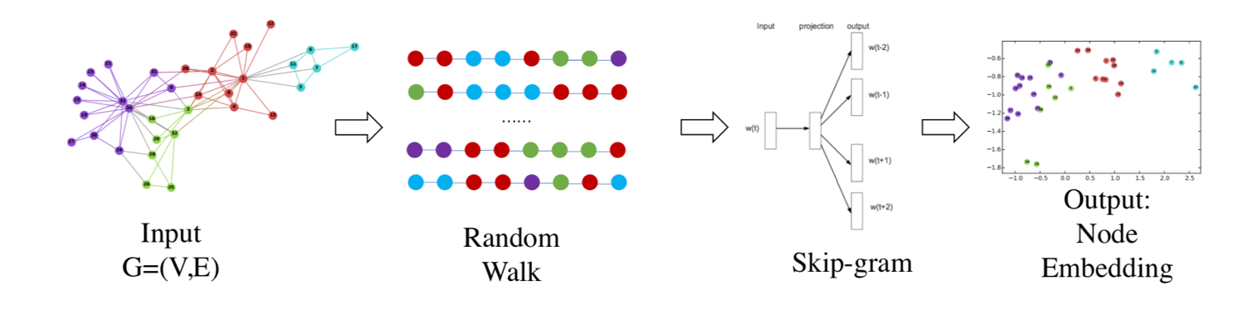
Node2Vec: Graph Embedding Technique
Node2Vec is an approach intended for constructing an embedding of a given graph to Euclidian space
Node2Vec starts by generating random walks within the graph, like a random path that starts at a node and traverses the graph by randomly choosing neighboring nodes to visit.
As these random walks progress, they create sequences of nodes. Each sequence represents a unique path through the graph.
Node2Vec treats these node sequences as if they were sentences in natural language. It applies techniques from word embedding models like Word2Vec, such as the Skip-gram model or Continuous Bag of Words CBOW).
Notes:
Graph -> Random Walks -> Skip-Grams -> Node embeddings
Graph
Random Walks – p (return to parameter): control likelihood revisitng the previous node, a low value of p encourages exploring new nodes, high value of p encourages revisiting previous noeds. And q (in-out parameter): control balance between DFS and BFS (high q more BFS, low q more DFS)
Skip-grams - One random walks is done, node2vec treats the skip-grams as sequence of nodes, this step help to learn the representation of nodes.
Node Embeddings – final output of node2vec (vector) can be used for node calssification , link prediction, clustering.

Slide 10
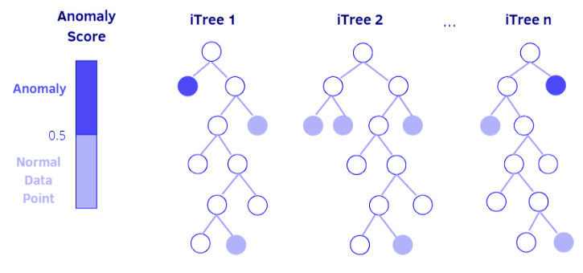
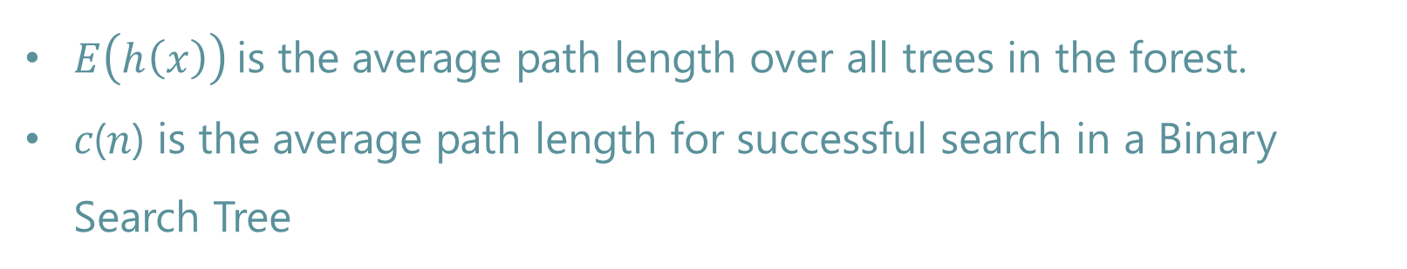
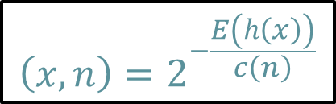
Isolation Forest For Anomaly Detection
Isolation Forest isolates anomalies by randomly partitioning data points. Anomalies are easier to isolate because they are few and different from the rest of the data.
Tree-based structure: Isolation Forest builds multiple random decision trees (called iTrees). Points that are isolated with shorter path lengths are more likely to be anomalies.
Random Partitioning: Each iTree randomly selects an attribute and splits the data, creating a hierarchy of partitions. Anomalies require fewer partitions to be isolated.
Anomaly Score: The algorithm assigns an anomaly score based on the average path length of the point across all iTrees. Shorter paths indicate higher anomaly likelihood.
$$\left(x,n\right)=2^{−\frac{E\left(h\left(x\right)\right)}{c\left(n\right)}}$$
$E\left(h\left(x\right)\right)$is the average path length over all trees in the forest.
𝑐(𝑛) is the average path length for successful search in a Binary Search Tree
Notes:
Graph -> Random Walks -> Skip-Grams -> Node embeddings
Graph
Random Walks – p (return to parameter): control likelihood revisitng the previous node, a low value of p encourages exploring new nodes, high value of p encourages revisiting previous noeds. And q (in-out parameter): control balance between DFS and BFS (high q more BFS, low q more DFS)
Skip-grams - One random walks is done, node2vec treats the skip-grams as sequence of nodes, this step help to learn the representation of nodes.
Node Embeddings – final output of node2vec (vector) can be used for node calssification , link prediction, clustering.

Slide 11
Model’s Process
N Iteration
Dataset Insertion
Node2Vec
Isolation Forest
GFCN
Results
“Graph”
Random Tree Construction
Apply Graph Convolution
Random Walks
Anomaly Scoring
Skip Connection
Skip Grams
Scored Dataset
Implicit Fairing
Node Embedding

Slide 12







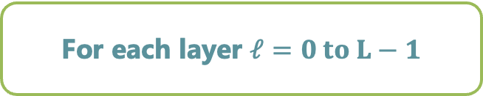
Elaborate diagram of GFCN
Input: Adjacency Matrix & Initial Feature Matrix X
No
Last Layer?
Normalize Adjacency Matrix
Yes
Final Node Embeddings
$$H^{L}$$
Layer 0: $X=H^{(0)}$
Skip Connection: $X{\tilde{Θ}}^{(0)}$
Apply Softmax for Classification
For each layer $ℓ=0 to L−1$
Combine: GC + Skip Connection
Graph Convolution:
$$D^{−\frac{1}{2}}AD^{−\frac{1}{2}}{H^{(0)}Θ}^{(0)}$$
Output: Predicted Labels $\hat{Y}$
Apply Activation Function
$$σ$$
Output: $H^{ℓ+1}$

Slide 13
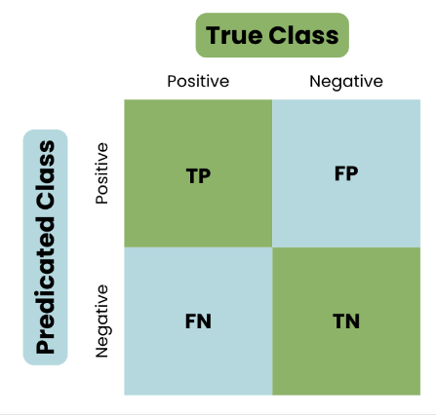
Testing and Evaluation Plan
Case | Test Case | Expected Result
Node2Vec q & p suited values | Run Node2Vec on a sample graph dataset with q = 0.25 and p = 0.5 | Node embeddings are generated and stored for each node in a low-dimensional space with a meaningful clustering and clear separation of anomalies
Isolation Forest Detection | Assess how varying the number of trees affects anomaly detection performance when n_estimators = 150 | Anomalies are identified based on short path lengths in the Isolation Forest, and nodes with high anomaly scores are flagged + number of trees that provides the best balance between performance and computational efficiency.
Scalability with Large Dataset | A large citation graph dataset with over 5000 nodes and edges | The entire pipeline (Node2Vec, Isolation Forest, and GFCN) runs efficiently within an expected time frame, scaling with the dataset size.
Evaluation Metrics | Detection against ground truth | precision > 0.75, recall > 0.70
GFCN Integration | Entered Results From Isolation Forest Into GFCN | GFCN accepts the input without errors and maintains the integrity of the data format
Notes:
^{Maybe needs changing}

Slide 14

Expected Achievements
The objective is to achieve high detection accuracy for anomalies by leveraging a combination of Node2Vec, Isolation Forest, and Graph Fairing Convolutional Networks (GFCN).
We aim to suggest a new nested approach for citation anomaly detection

Slide 15
Thank You!

